Slide 1


HOUSEKEEPER FINDER
ALX - SE Portfolio Project Presentation
By: DIGHO D. T. Jordan

Slide 2
PRESENTATION PLAN
Team Members introduction
The origin of the project idea
Technologies and Architecture
Algorithms and Code Snippet
Challenges
Technical aspects learned
Conclusion

Slide 3
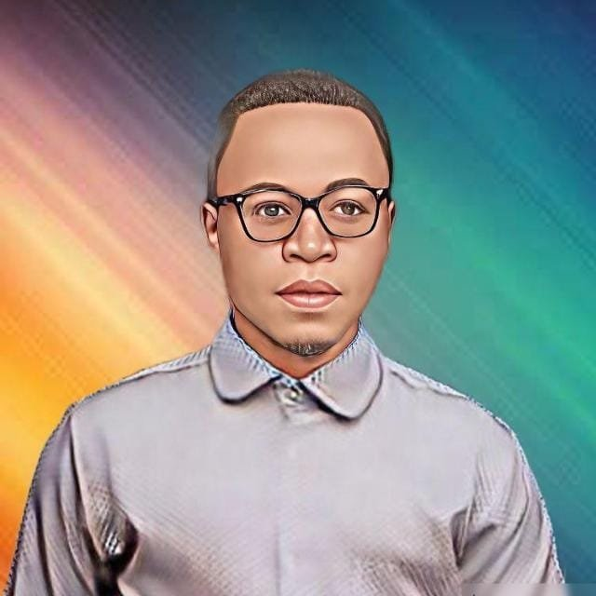
Team Member Presentation
I am DIGHO DONMEZA TANKEU Jordan originating from Cameroon
I am presently living in China
I started the ALX - SE program around september 2022 and have deferred the program twice due to some occupations.
Notes:
I worked on this project alone so as to go through all the development process and try to make something out of it.

Slide 4
HOUSEKEEPER
Project description
The housekeeper project is one which have a general idea of connecting together people in need of assistance in some house tasks.

Slide 5
HOUSEKEEPER
Origin of the Idea
When I was still in Cameroon, I had a friend who was not working and was actively in search of something to do. In the other hand, one day while talking with one of our supervisors in the company I was doing internship, she mentioned her need of somebody to do some services for her in the house (dropping and picking the children in school, cleaning the house, watching on the children while she gets back from work...)
Notes:
The idea did not immediately hit up in my mind at that time until few days later I realized it could be a good project to work on. When I had the opportunity in this portfolio project for the ALX - SE program, I decided that I will start working on it.

Slide 6



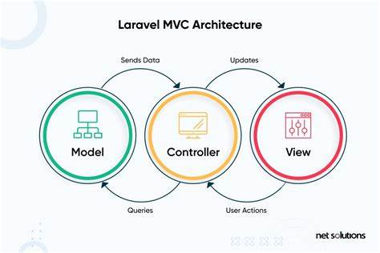

HOUSEKEEPER
Technologies and Architecture
To realise this project, I made us of:

Slide 7
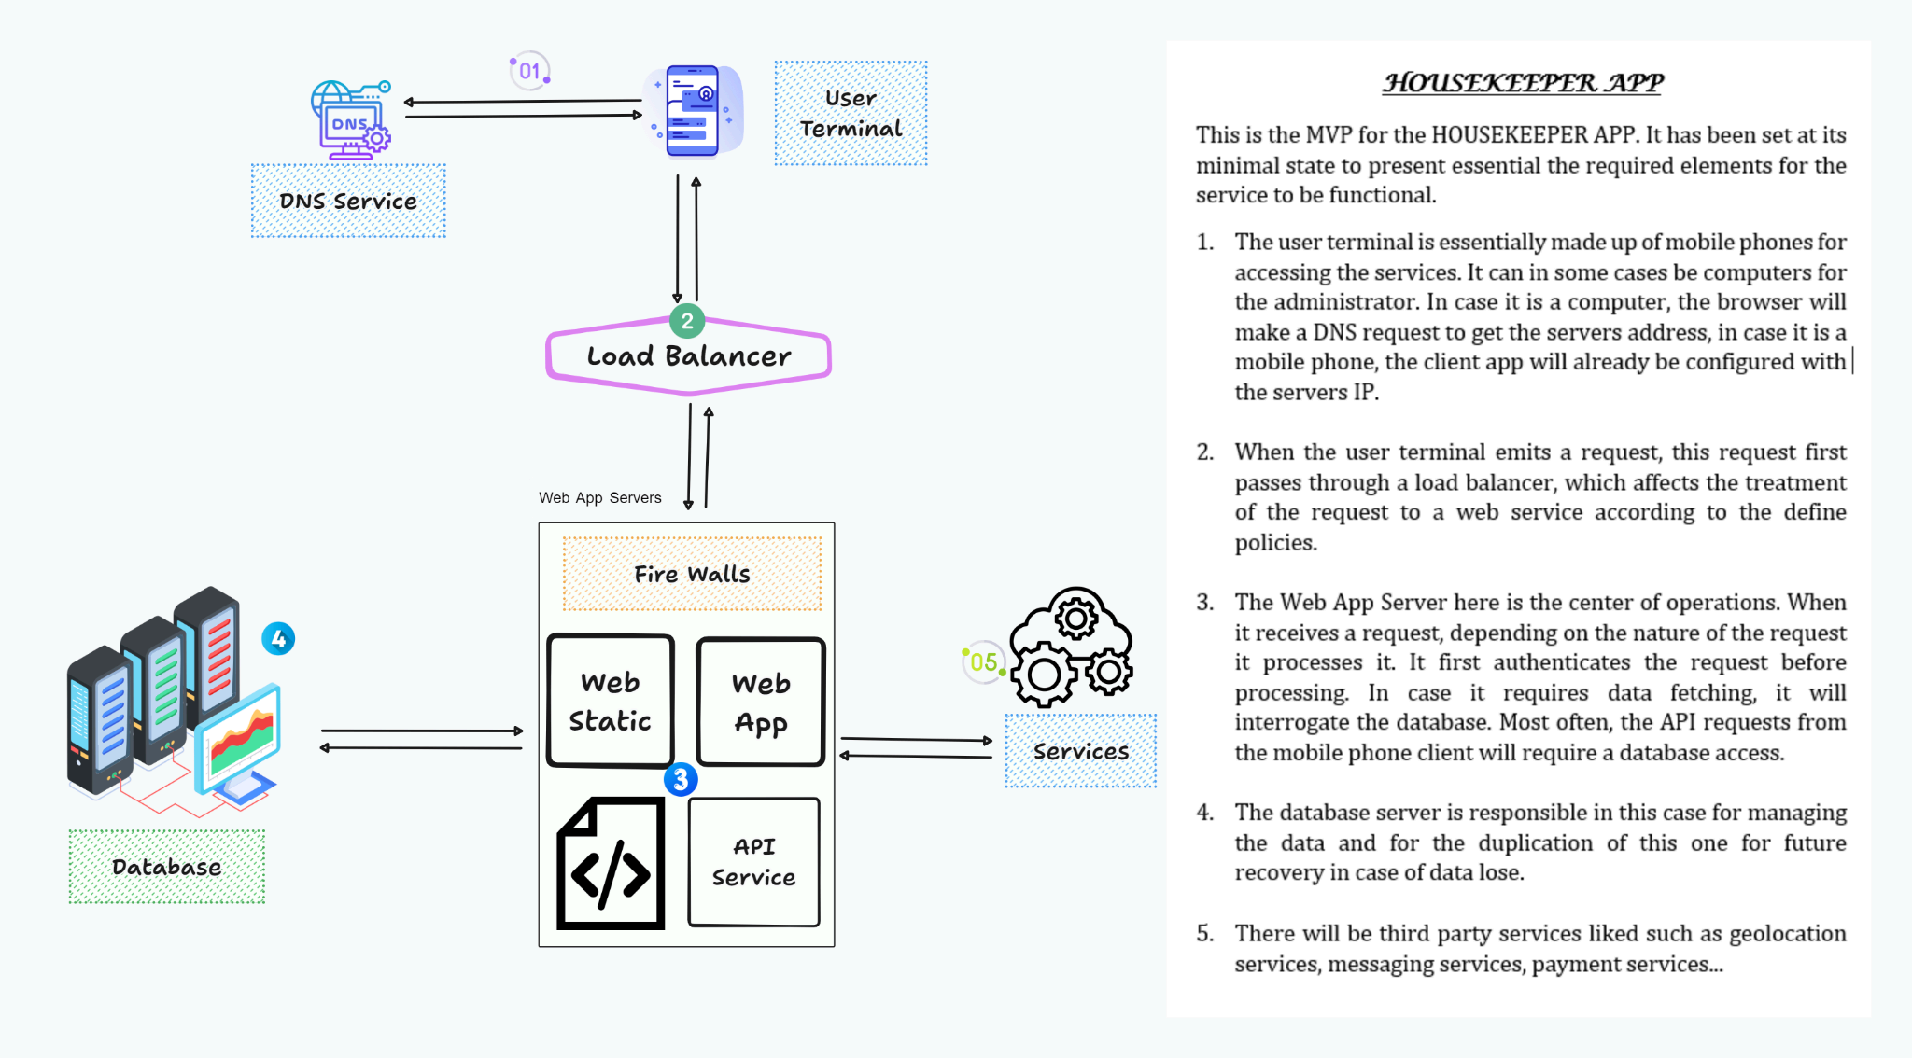
HOUSEKEEPER
Architecture

Slide 8
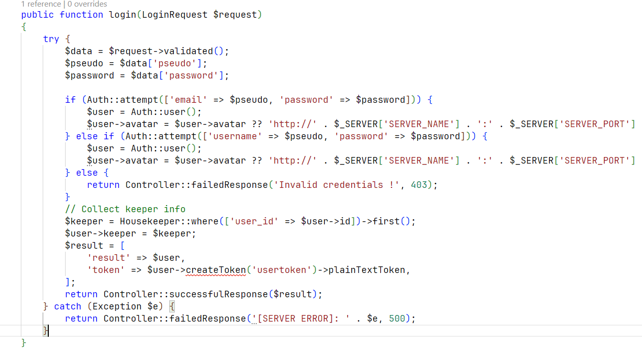
HOUSEKEEPER
Algorithms and Code Snippets
Basic Authentication Function (Login)

Slide 9
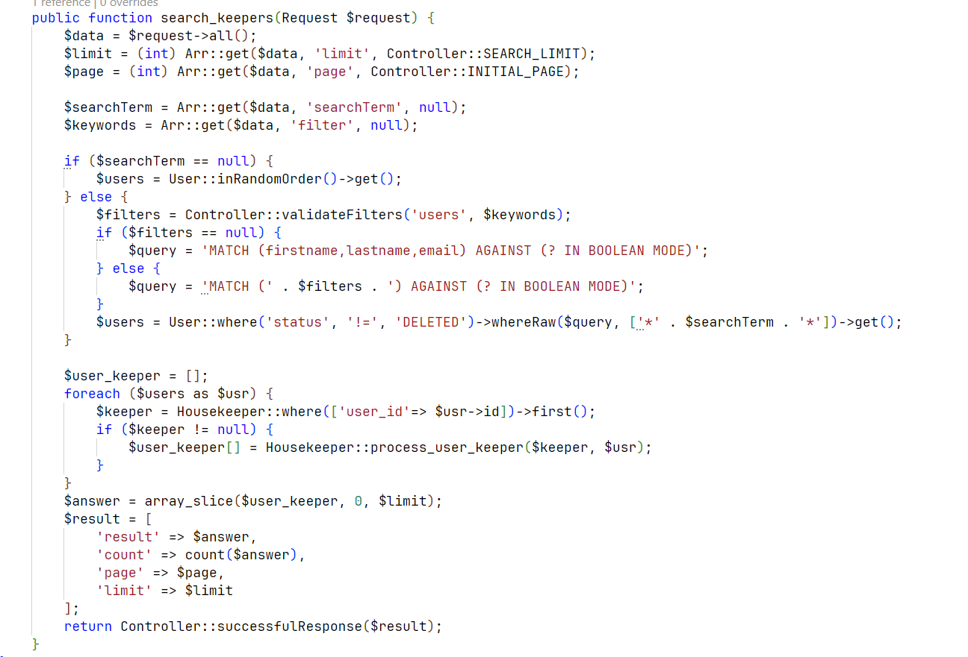
HOUSEKEEPER
Algorithms and Code Snippets
HouseKeeper Search Function (Based on some Characteristics)

Slide 10
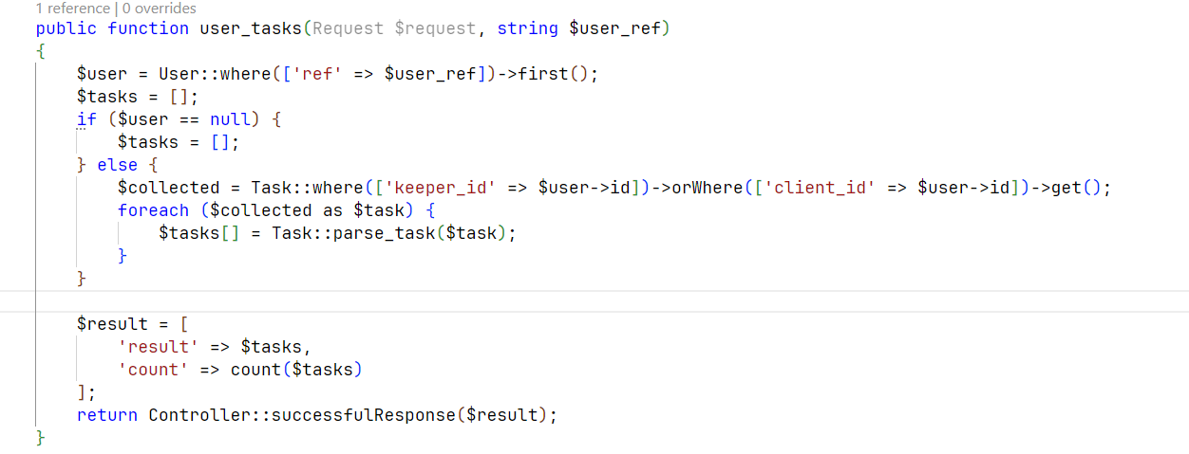
HOUSEKEEPER
Algorithms and Code Snippets
User tasks selection Function

Slide 11
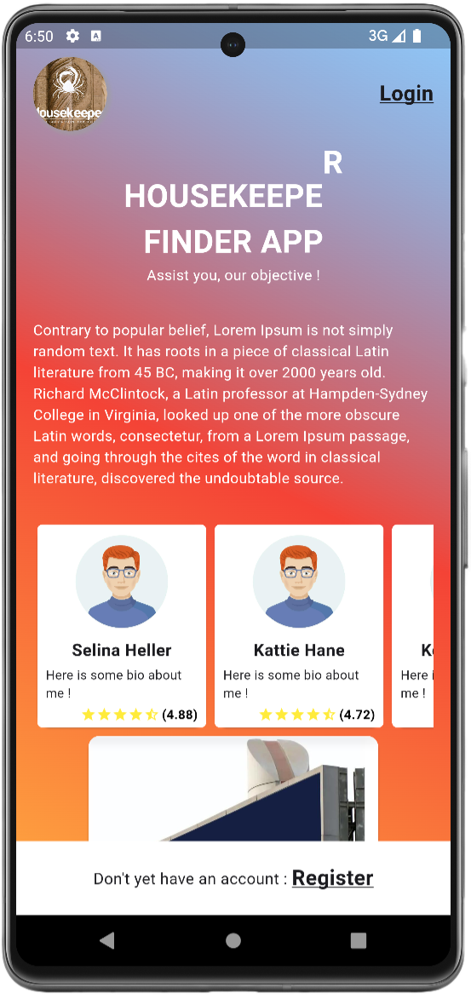
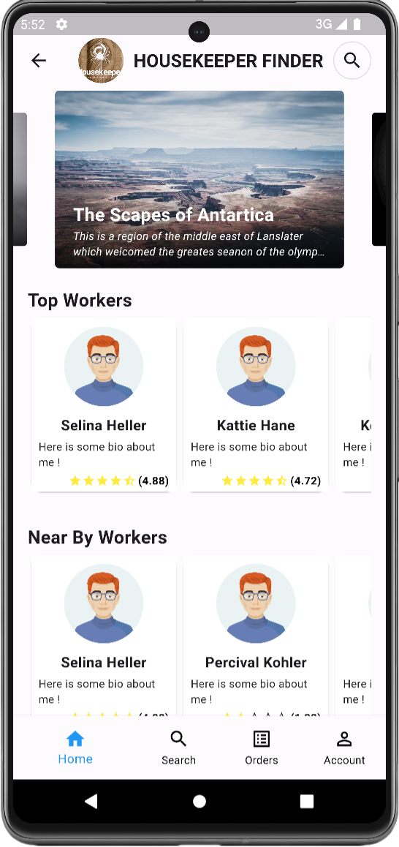
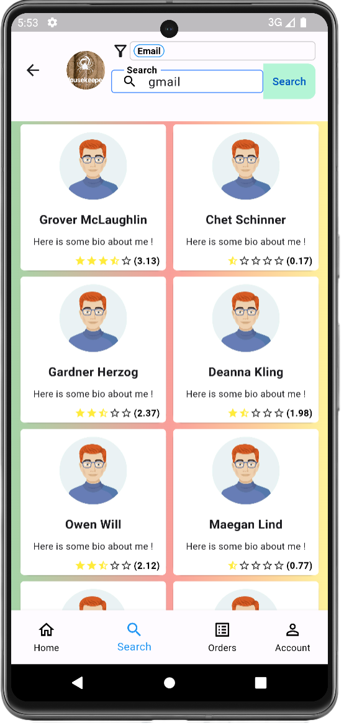
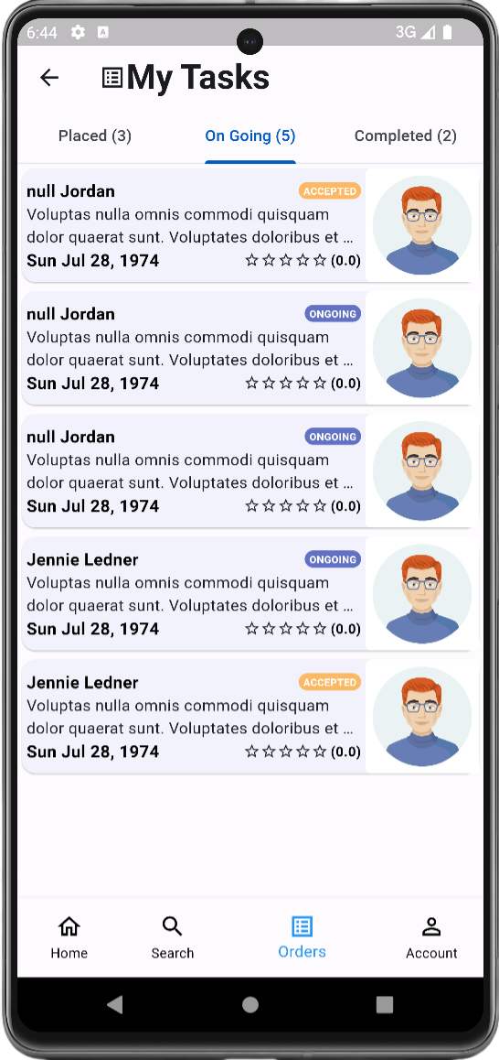
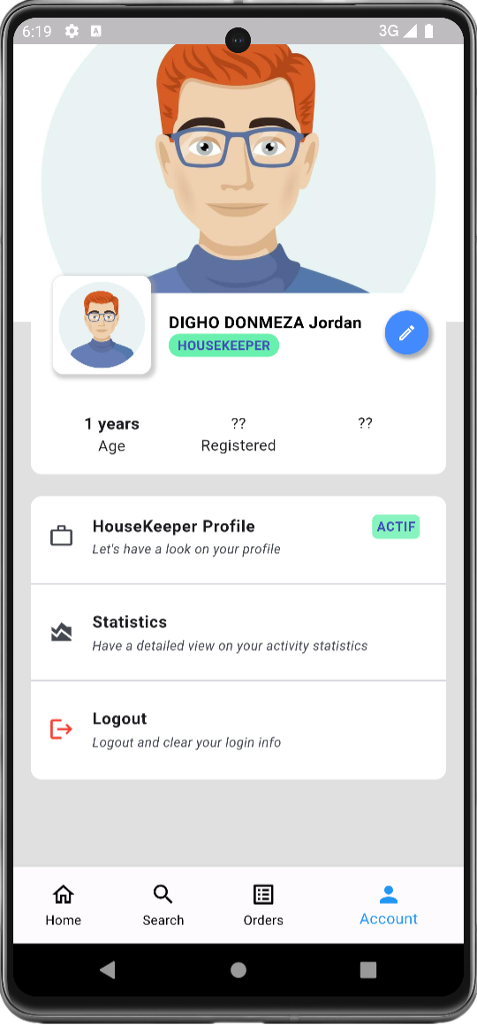
HOUSEKEEPER
Mobile App Interfaces
Wecome Page
Home Page
Search Page
Tasks Page
Profile Page

Slide 12
HOUSEKEEPER
Challenges encountered
Resource access and some necessary services
App Design Skills
Organisation

Slide 13
HOUSEKEEPER
Technical Aspects Learned
Development best practices
Server Configuration
Hosting from crash and putting online an app successfully for the first time
...

Slide 14
HOUSEKEEPER
Conclusion
This phase of ALX - SE program was a deep and intern one, filled with many things to practically assimilate at once. It was also filled with alot of expectations on what will come out from the efforts given. It is not yet perfect but I can say I’m happy of the distance covered till present and waiting for more to come.

Slide 15


